Slide 1




Towards delay-aware container-based
Service Function Chaining in Fog Computing
José Santos, Tim Wauters, Bruno Volckaert, Filip de Turck
IEEE/IFIP Network Operations and Management Symposium (NOMS 2020)
20 – 24 April 2020 – Budapest, Hungary

Slide 2
Outline
How can we deal with Service Function Chaining (SFC) in Fog Computing?
How can we support SFC in Fog Computing?
How can we evaluate our approach?

Slide 3
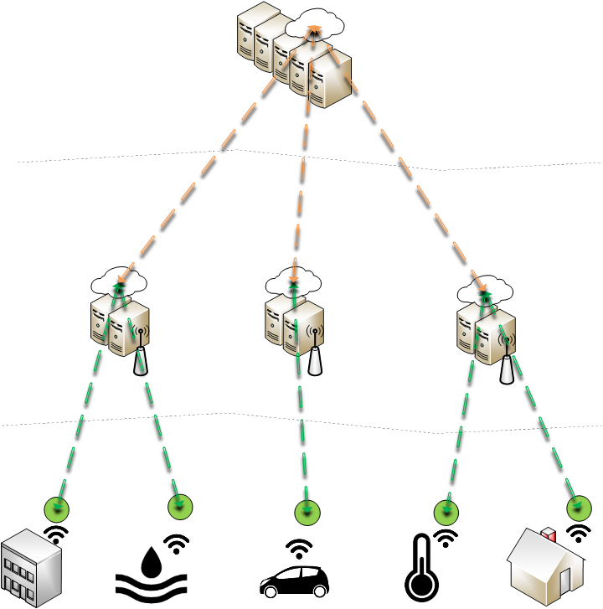
Fog Computing
Cloud
High Computing Power
High Latency
Fog
Medium Computing Power
Low Latency
IoT Devices
Low Computing Power

Slide 4
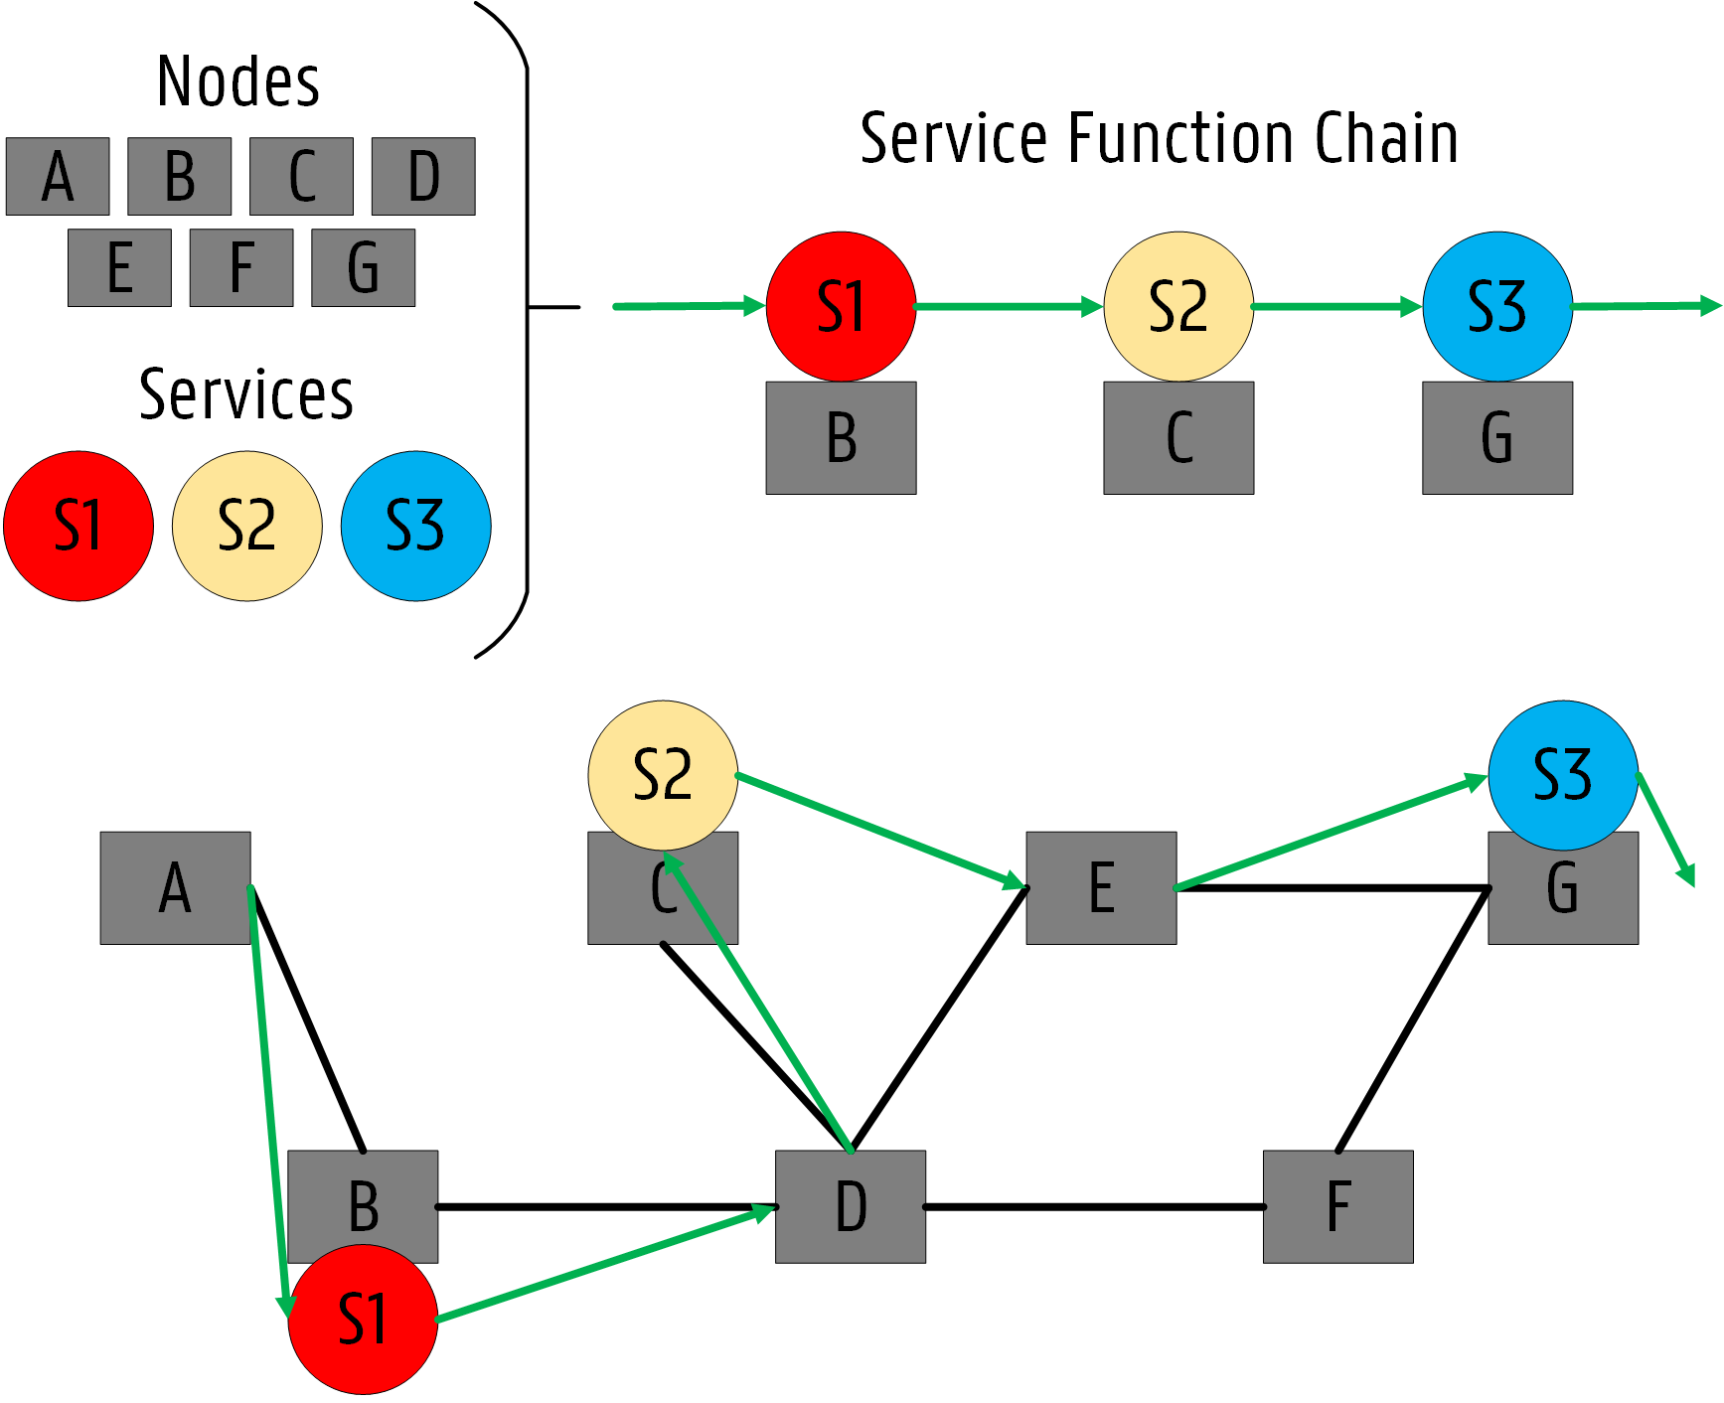
Service Function Chaining (SFC)
How can we incorporate SFC in Fog Computing?

Slide 5
Outline
How can we deal with Service Function Chaining (SFC) in Fog Computing?
How can we support SFC in Fog Computing?
How can we evaluate our approach?

Slide 6
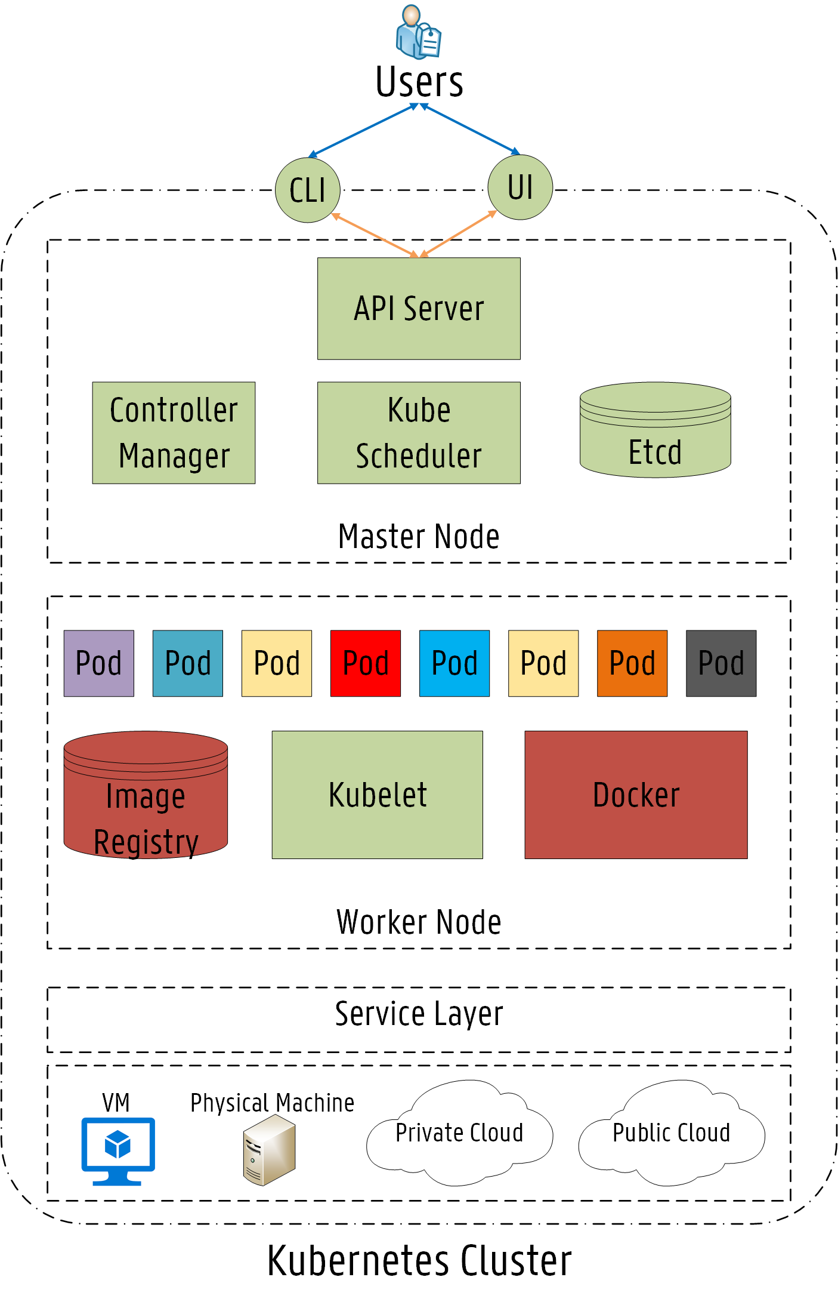

Kubernetes
Container Orchestration Platform
Robust & Reliable
Scaling up Containers (Docker)
Massive Open Source Community

Slide 7
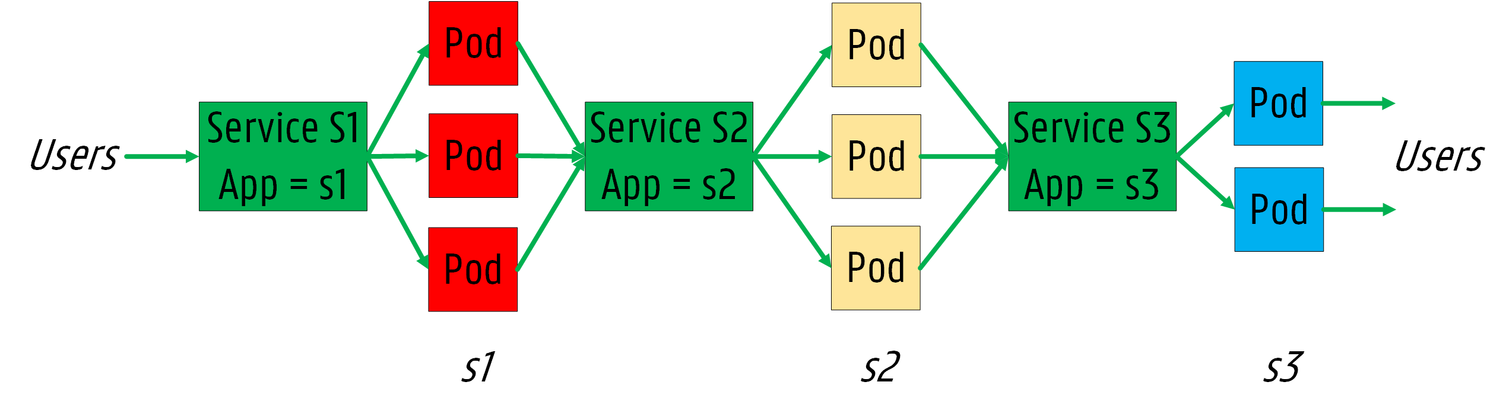
SFC concepts in Kubernetes

Slide 8
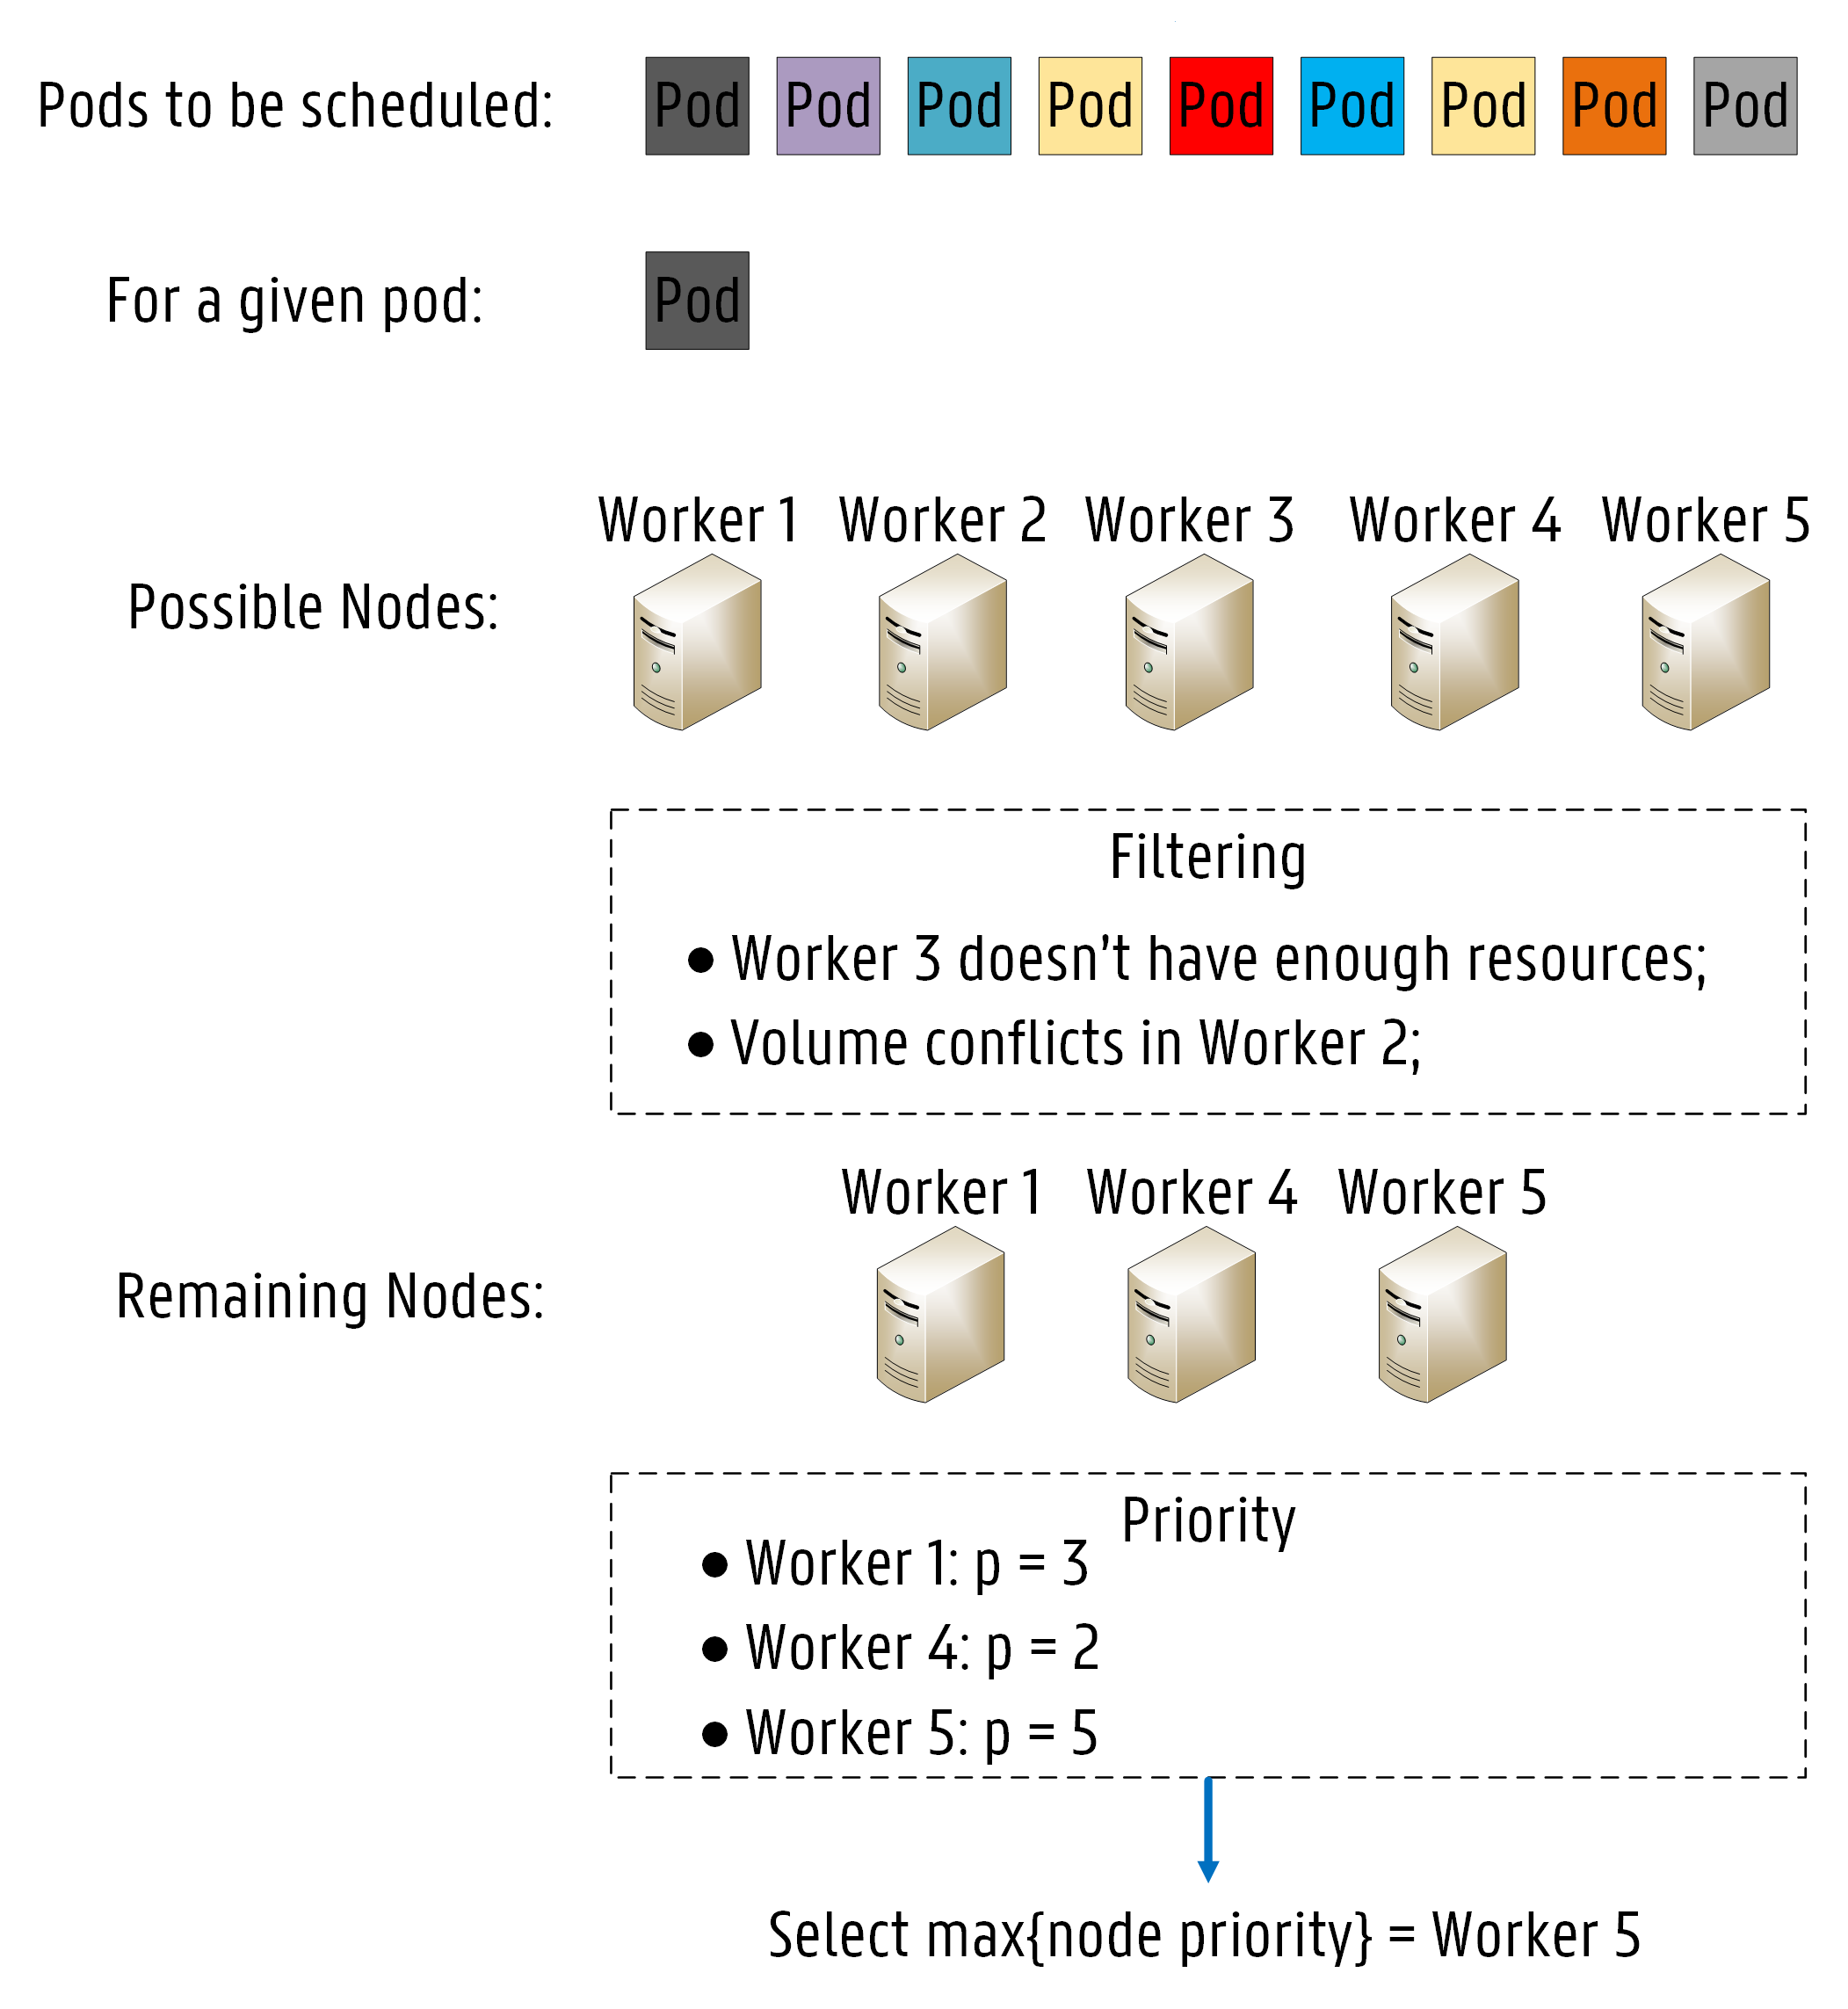
Kube-Scheduler (KS)
How does it work?
1
Node Filtering
2
Node Priority Calculation

Slide 9

Kube-Scheduler (KS)
Fast Decision Time
Easily extensible
Lack of specific rules
Only CPU and RAM

Slide 10
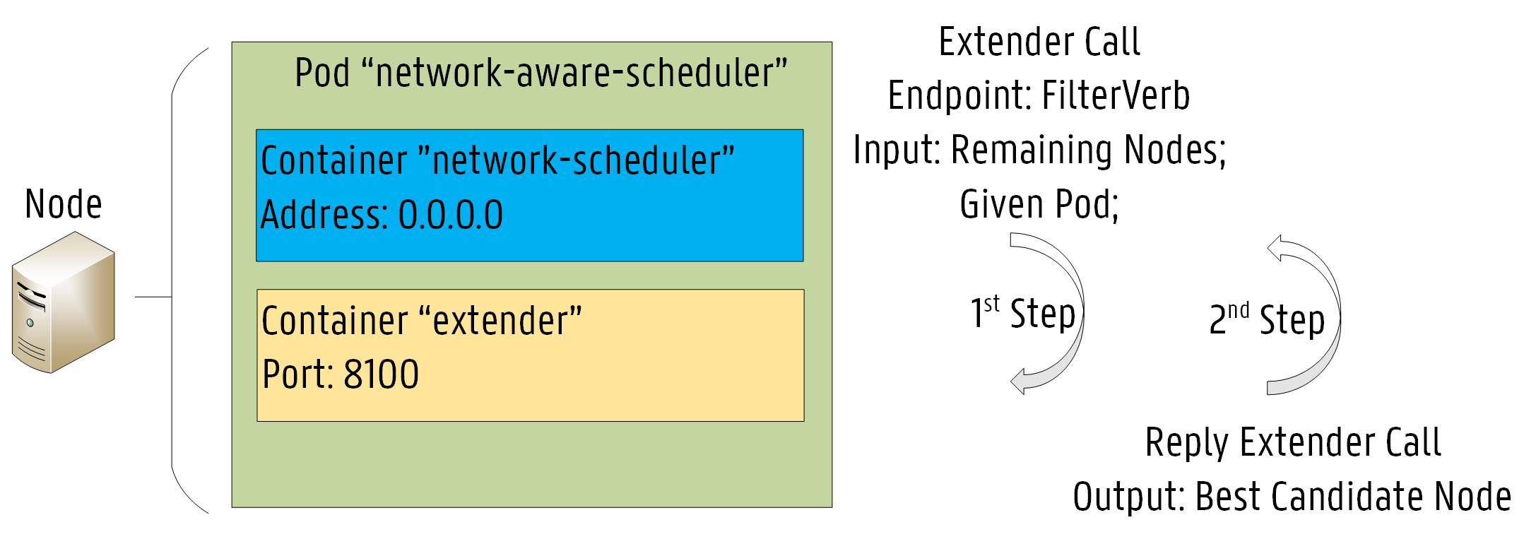
Network-Aware Scheduler
Implemented by extending KS:
1
Node Filtering
2
Minimization of RTT
Bandwidth Conservation
Santos, José, et al. "Towards Network-Aware Resource Provisioning in Kubernetes for Fog Computing applications." 2019 IEEE Conference on Network Softwarization (NetSoft). IEEE, 2019.

Slide 11
SFC controller
Extension to the Network-Aware Scheduler:
1
SFC information in Pod configuration files
2
Provisioning strategies

Slide 12
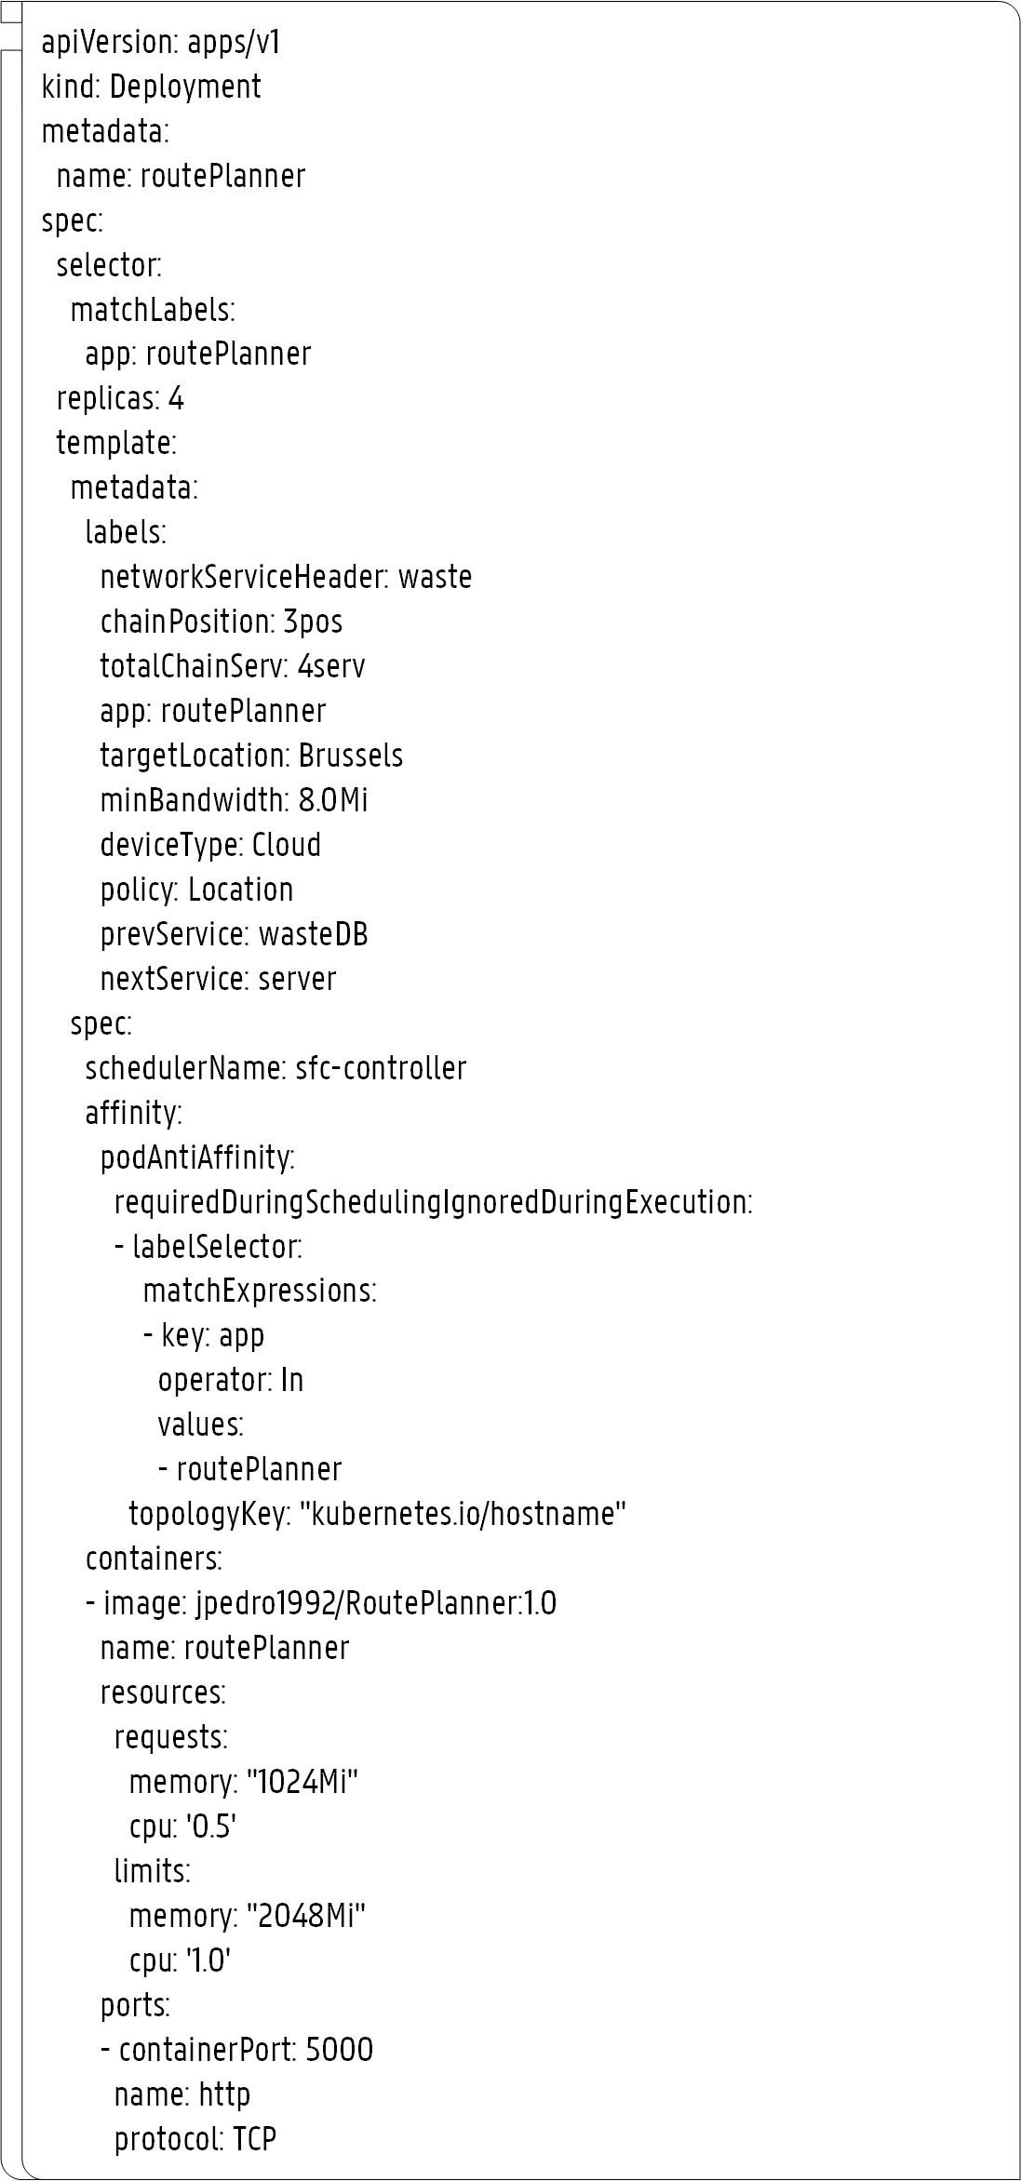
SFC controller
SFC information in Pod configuration files
1
Network Service Header
2
Chain Position
SFC Information
3
Total Services
4
Target Location
5
Minimum bandwidth
6
Policy
7
Previous Service
8
Next Service

Slide 13
SFC controller
Select Best Candidate Node
Main procedure
Policy == Location
Policy == Latency
Location-aware algorithm
Latency-aware algorithm
Node not available
Node available
MAX Residual Bandwidth Link
Store pod provisioning record
No Suitable Node!
Raise a Pod Eviction
Update node available bandwidth

Slide 14
Outline
How can we deal with Service Function Chaining (SFC) in Fog Computing?
How can we support SFC in Fog Computing?
How can we evaluate our approach?

Slide 15
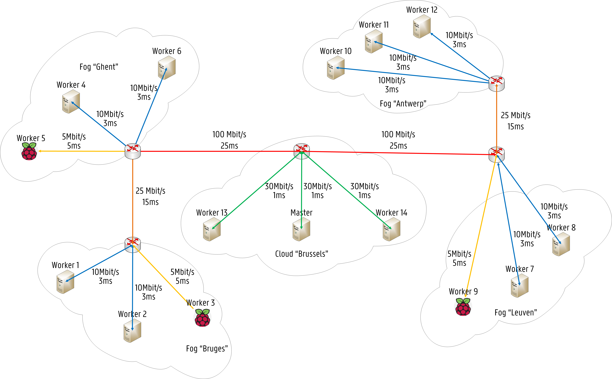
Evaluation Scenario
Delay Labels (e.g. Worker 1)
1
Bruges: 3.0 ms
2
Ghent: 18.0 ms
3
Antwerp: 83.0 ms
4
Leuven: 68.0 ms
5
Brussels: 43.0 ms
6
Av. Bandwidth: 10Mbit/s

Slide 16
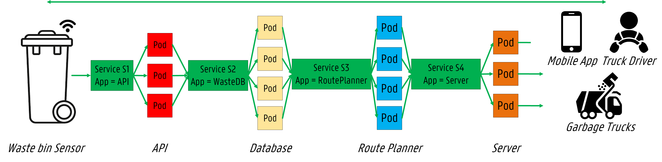
Use Cases
1
Waste Management

Slide 17
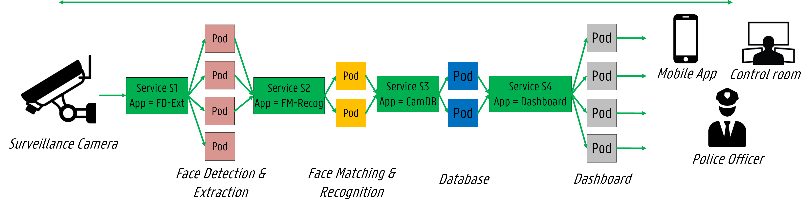
Use Cases
2
Surveillance Camera

Slide 18
Deployment Properties (e.g. waste management use case)
1
api
Replication Factor: 3
Chain Position: 1
Total Services: 4
Policy: Latency-Aware
Target Location: Any
Min. Bandwidth: 4.0 Mbit/s
Prev Service: None
Next Service: waste-db
2
route-planner
Replication Factor: 4
Chain Position: 3
Total Services: 4
Policy: Location-Aware
Target Location: Brussels
Min. Bandwidth: 8.0 Mbit/s
Prev. Service: waste-db
Next Service: server

Slide 19
Results

Slide 20
Execution Time
 | Extender Decision | Scheduling Decision | Pod Startup Time
KS | 0 ms | 3.21 ms | 2.83 s
SFC controller | 6.08 ms | 8.38 ms | 2.96 s

Slide 21
Allocation Scheme
Use Case | Services | KS | SFC Controller
 | api | [Worker 5, Worker 11, Worker 12] | [Worker 3, Worker 5, Worker 7]
 | waste-db | [Worker 1, Worker 4, Worker 10, Master] | [Worker 4, Worker 10, Worker 11, Worker 14]
 | route-planner | [Worker 1, Worker 4, Worker 11, Master] | [Worker 6, Worker 13, Worker 14, Master]
 | server | [Worker 6, Worker 10, Master] | [Worker 13, Worker 14, Master]
 | fd-ext | [Worker 1, Worker 4, Worker 5, Worker 12] | [Worker 1, Worker 2, Worker 12, Master]
 | fm-recog | [Worker 3, Worker 4] | [Worker 13, Master]
 | cam-db | [Worker 3, Worker 4] | [Worker 7, Worker 8]
 | dashboard | [Worker 1, Worker 4, Worker 10, Master] | [Worker 8, Worker 9, Worker 10, Worker 11]

Slide 22
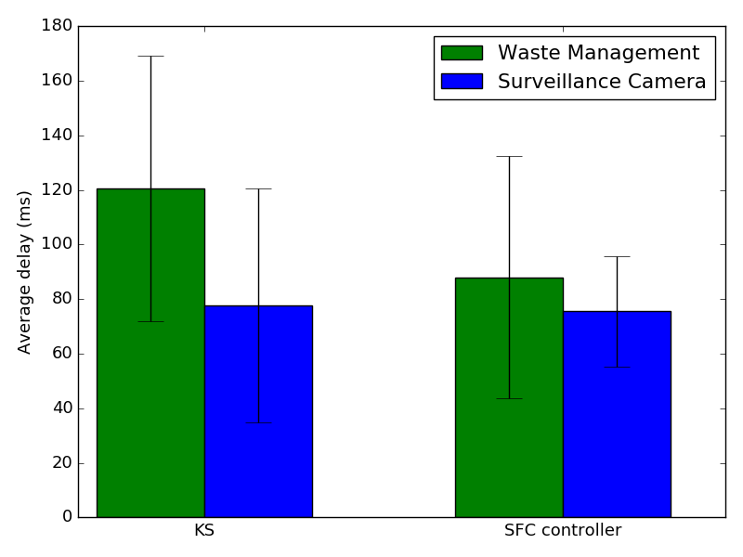
Average Service Latency
18%
Fig. 8: The expected service latency for each of the schedulers.

Slide 23
Network Bandwidth
Worker Node | KS (Mbit/s) | SFC Controller (Mbit/s)
Worker 1 | 26.0 | 8.0
Worker 2 | - | 8.0
Worker 3 | 10.5 | 4.0
Worker 4 | 36.5 | 5.0
Worker 5 | 12.0 | 4.0
Worker 6 | 4.0 | 8.0
Worker 7 | - | 6.5
Worker 8 | - | 7.5
Worker 9 | - | 5.0
Worker 10 | 14.0 | 10.0
Worker 11 | 12.0 | 10.0
Worker 12 | 12.0 | 8.0
Worker 13 | - | 20.0
Worker 14 | - | 17.0
Master | 22.0 | 28.0
KS Overloads several nodes!
1
Worker 1: 26.0 Mbit/s
2
Worker 3: 10.5 Mbit/s
3
Worker 4: 36.5 Mbit/s
4
Worker 5: 12.0 Mbit/s
5
Worker 10: 14.0 Mbit/s
6
Worker 11: 12.0 Mbit/s
7
Worker 12: 12.0 Mbit/s

Slide 24
Conclusions
SFC Allocation in Fog computing
Validated in Kubernetes.
Results
18% reduction of service latency while conserving bandwidth
Future Work
Dynamic strategies added to our SFC controller

Slide 25

Thank you for your attention!
Questions?
José Santos
Ghent University – imec, IDLab
Josepedro.pereiradossantos@UGent.be
Interested?
Repository: github.com/jpedro1992/sfc-controller
Demo presentation: accepted for NETSOFT 2020

Slide 26
SFC controller
Latency-aware algorithm
Latency-aware algorithm
Select node based on Shortest Paths calculation
node
If node == null
If node != null
Location-aware algorithm
Return node

Slide 27
SFC controller
Location-aware algorithm
Location-aware algorithm
Repeat the process! (Recursive)
Select node based on minimum Delay for target location
node
If node does not have enough bandwidth
If node has enough bandwidth
Remove Node from Potential Candidates
Return node
Node List != null
Node List == null
Return null

Slide 28
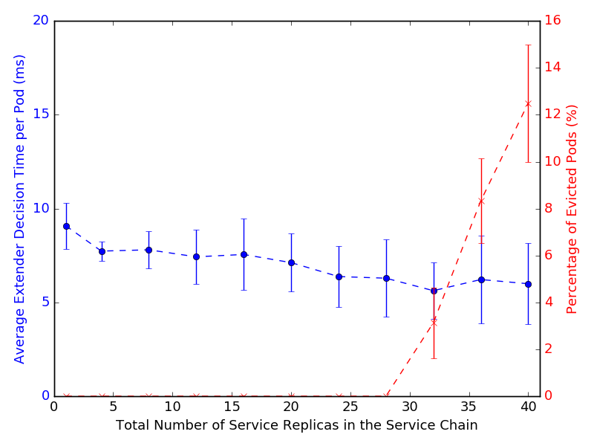
Scalability
Fig. 9: The average execution time per Pod of the SFC controller extender call.

